Slide 1
Welcome on Board Project life cycle
GOOD JOB!
HELLO
Have fun!
Here is where our journey begins

Slide 2
Project Life Cycle
01
02
03
04
05
Analysis
Design
Development
Testing
Deployment

Slide 3
01
Analysis phase
Go Ahead
Let’s do it!

Slide 4
Analysis phase
Inputs :
Meet with the client to gather the requirements
or Get the proposal file without meeting with the clients.
Outputs :
Proposal file if not found
Scope of work for the project
Wireframes for the project portals “app / web / dashboard”
Flowcharts
User-stories
Review design if fits requirements
Write CR points
Organize Kickoff meeting to deliver the project business to the team.

Slide 5
02
Design phase
Go Ahead
Let’s do it!

Slide 6
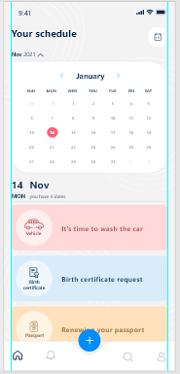
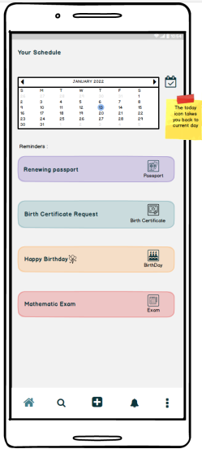
Design phase UI/UX
Inputs :
Attends the Kickoff meeting to receive the project business from analyst.
Receive Wireframes from analyst
Outputs:
Send final design screens / pages to the analyst
Design Logo

Slide 7
Design phase UI Developer
Inputs :
Attends the Kickoff meeting to receive the project business from analyst.
View Design from UI/UX.
Or Receive Wireframe directly from analyst
Outputs:
Coding the design and making it more interactive.

Slide 8
03
Development phase
Go Ahead
Let’s do it!

Slide 9
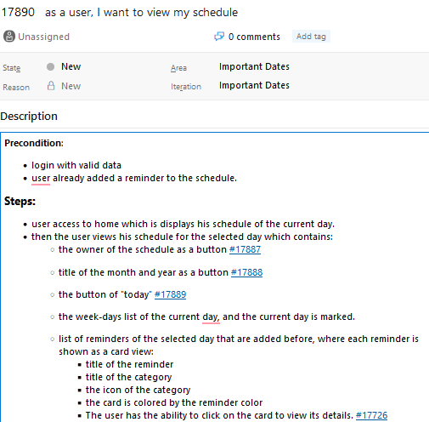
Development phase Mobile Developer
Inputs :
Attends the Kickoff meeting to receive the project business from analyst.
View Wireframes from analyst
Read User-story from analyst
View Flowchart from analyst
View Design from designer
Receive APIs from backend developer
Outputs:
Coding the design by reading the user-story with the of wireframes and flowcharts and make it useable.
Resolve user-stories and the bugs\issues if any.

Slide 10
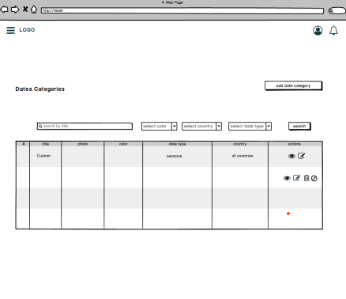
Development phase Backend Developer
Inputs :
Attends the Kickoff meeting to receive the project business from analyst.
View Wireframes from analyst
Read User-story from analyst
View Flowchart from analyst
View UI design if any from UI developer.
Outputs:
Coding the design by reading the user-story with the of wireframes and flowcharts and make it useable.
Send APIs to mobile developer if any.
Resolve user-stories and the bugs\issues if any.

Slide 11
04
Testing phase
Go Ahead
Let’s do it!

Slide 12
Testing phase
Inputs :
Attends the Kickoff meeting to receive the project business from analyst.
Test the system after coding feature by feature and test all system
Outputs:
Write issues / bugs / tasks if any to developer [backend / mobile]
Check that the system fits with requirements along with the analyst.
Use-case testing

Slide 13
04
Deployment phase
Go Ahead
Let’s do it!

Slide 14
Deployment phase
Inputs :
Tester or Analyst make a demo meeting to deliver one or more modules of the system after coding and testing.
Or deliver all the system after coding and testing.
Outputs:
Gets notes from the client.
Write/send minutes of meeting with the points are discussed and the notes are taken to the client and project team. (General case after any meeting)

Slide 15
Thanks!
GOOD JOB!
Do the best
Have fun!
Here is where our journey ends

